Slide 1
Why and How We Write

Slide 2
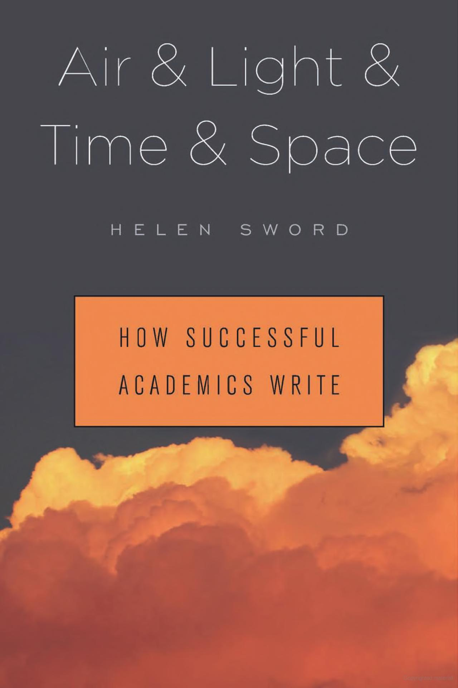
Source and Inspiration

Slide 3
Listen to other people’s advice, but that doesn’t mean you should follow it
Janet Currie, Princeton University

Slide 4
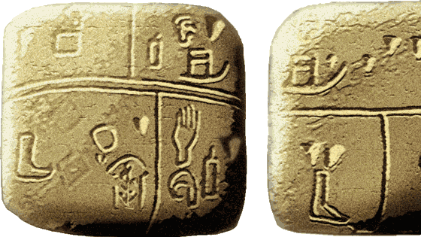
Why Write?
The Kish tablet from Sumer, with pictographic writing. This may be the earliest known writing, 3500 BCE. Ashmolean Museum

Slide 5
Why Write?
A means of rendering language into a form that can be reconstructed by other humans separated by time and/or space.
Wikipedia
“The rule is simple: if you don’t write it down, it never happened.”
Michael Lopp

Slide 6
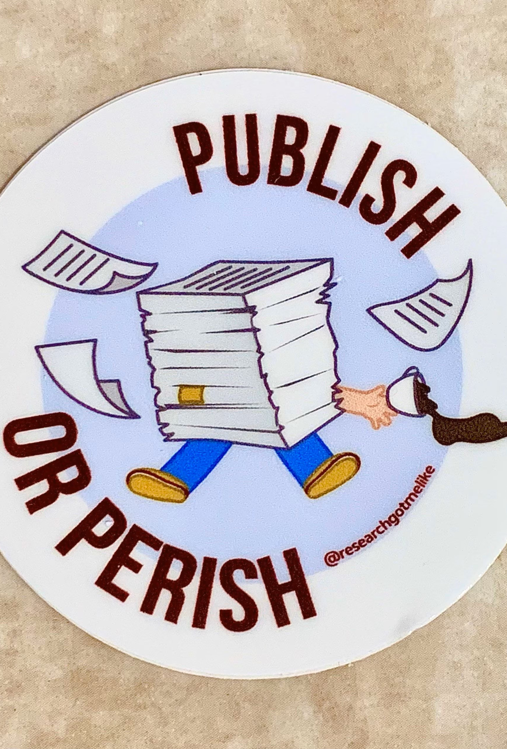
WRITE!
Etsy - Researchgotmelike

Slide 7
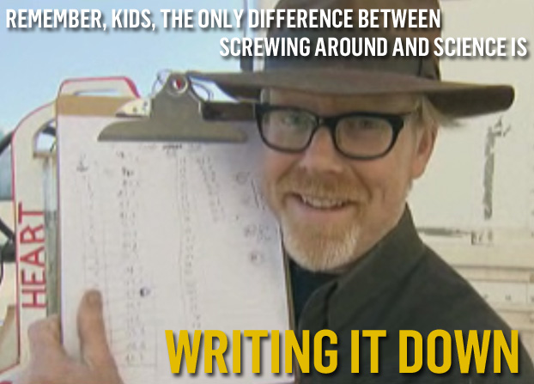

Slide 8
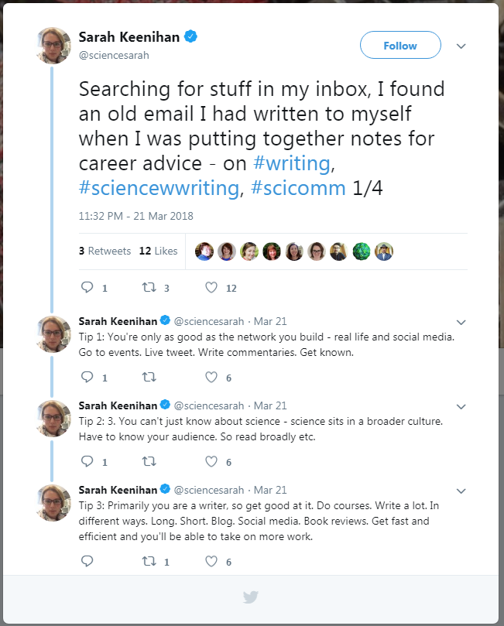
Primarily you are a writer, so get good at it.
Sarah Keenihan Twitter @sciencesarah

Slide 9
Publications ARE the Currency in Academics like Profits are in business.
Heather Talbott

Slide 10
Graduate School Writing
Thesis/Dissertation
Grants/Scholarships
Publications/Paper/Journal Article
Biographies/Personal Statements
Teaching materials
Progress reports

Slide 11
Preparing to Write

Slide 12

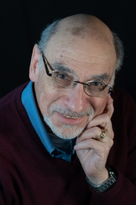

Sources and Inspiration
Stephen Heard, UNB, author of The Scientist Guide to Writing
Irving H. Zucker, UNMC
& Myron Toews, UNMC

Slide 13
Selecting Journal(s)
Audience
Scope/Focus/Fit
Open access/Subscription
Quality/Impact Factor/H-index
Cost in money/time
Likelihood of publishing/Rejection Rate
AVOID predatory/fake journals

Slide 14
Authorship
Important and sometimes contentious
Deciding early can help
Order – depends on field

Slide 15
Plagiarism is a Big Deal
Plagiarism includes:
1. quoting verbatim or almost verbatim from any source, including all electronic sources, without acknowledgement;
2. adopting someone else’s line of thought, argument, arrangement, or supporting evidence without acknowledgement;
3. submitting someone else’s work, in whatever form, without acknowledgement;
4. knowingly representing as one’s own work any idea of another.

Slide 16
What is your paper?
Your Paper is NOT
Your paper is
Your paper is not a diary.
Your paper is not a recipe.
Your paper is not an encyclopedia.
Your paper is designed to tell the reader the thing(s) you’ve decided they need to know.

Slide 17
Every paper needs to tell a story
In fiction, a “story” sets up and then resolves an interesting question in the reader’s mind.
How? By exposing characters to a plot.
A paper does the same thing.

Slide 18
How to Develop your story
Minisummary
Wordstack
Concept mapping
Outlining
Story summary
Subhead Outline
Figure shuffling

Slide 19
Minisummary
The minisummary is a 2-3 sentence distillation of your paper.
It includes the central question and its major answer.
“What is the structure of DNA? X-ray diffraction data suggest a double helix, with twin sugar-phosphate backbones connected by paired nucleotide bases.”

Slide 20
wordstack

Slide 21
Concept mapping

Slide 22
Outlining

Slide 23
story summary
What is the central question?
Why is this question important?
What data are needed to answer the question?
What methods are used to get those data?
What analysis must be applied for the data to answer the question?
What data were obtained?
What were the results of the analysis?
How did those results answer the central question?
What does this answer tell us about the broader field?
Notes:
(notice similarity to Gowin’s Vee, taught in Research Methods: Gowin 2005 amzn.to/3aZ0KiK)

Slide 24
subhead outline
The subhead outline is based on IMRaD structure
1. Introduction
1.1 Context in the field
1.2 Our central question
1.3 Our approach to the question
2. Methods
2.1 Study species and field site
2.2 Experimental methods
2.3 Statistical analysis
3. Results
3.1 The most important/exciting experiment
3.2 The second most important/exciting experiment/supporting information
4. Discussion
4.1 How results answer the question
4.2 Possible weaknesses, loose ends
4.3 Broader implication for the field

Slide 25
topic-sentence outline
Each paragraph in your paper will have a topic sentence.
All your (intended) topic sentences can be a detailed outline
Differs from subhead outline: each point is a statement, not a topic
For example:
not “3.1 The most important experiment”,
but “B-amaridine treatment of cell cultures led to dramatically increased differentiation of apparent vascular tissue”.

Slide 26
Figure shuffling

Slide 27
Don’t be Shackled by Your outline
An outline is a guide; but your story can change as you write it
An outline ignored is useless; but an outline as handcuffs blocks improvement
“will this change make my paper better?”

Slide 28
Assignment: Preparing to Write
Find and download/print author guidelines for
McNair Academic Professionals (MAP)
A journal your faculty mentor has published in
Create an outline of your paper (can use the ones presented or other strategies)
Review the outline with your faculty and graduate mentors
*Optional* Discuss with your faculty and graduate mentors how your summer research fits into their future publication plans
Reasonable Expectation: ~1 figure, secondary/tertiary/quat/etc authorship

